Slide 1
A SIMPLE AGRICULTURAL INFORMATION WEBSITE
BY KGATLISO MOLOBELA

Slide 2
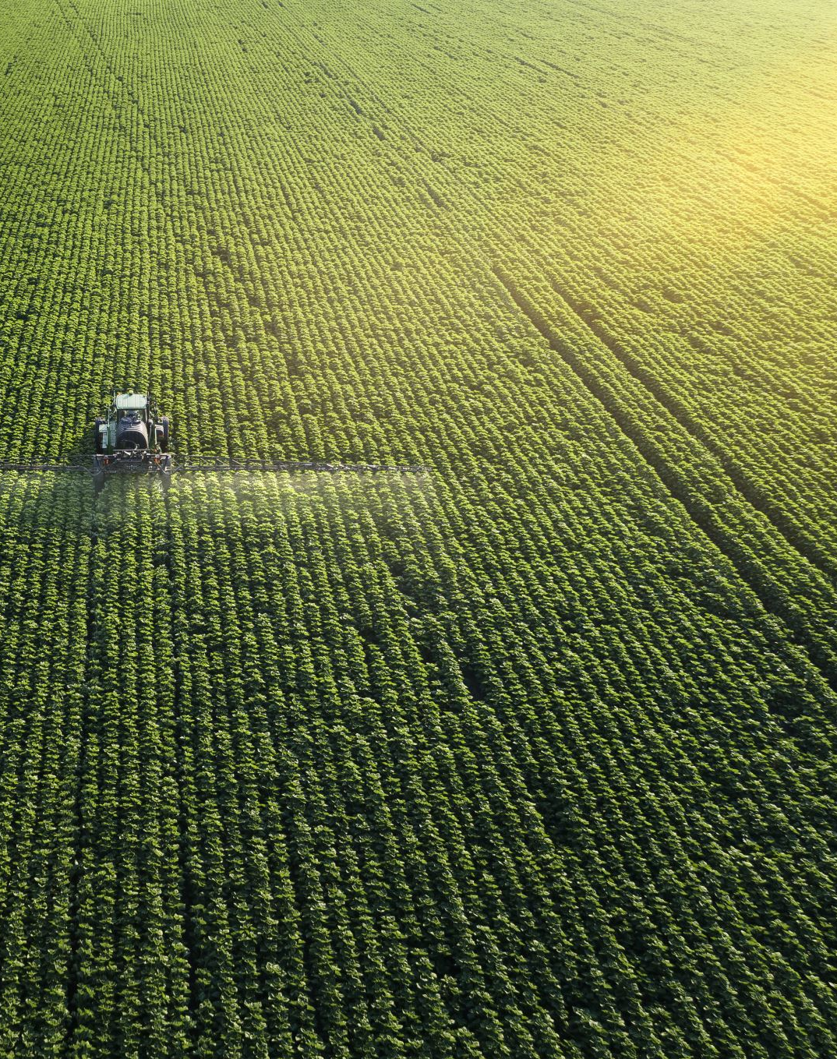
INTRODUCTION
Agriculture plays a vital role in food security and economic development.
However, many farmers still lack easy access to reliable agricultural information.
This project uses digital technology and IoT concepts to support farmers with essential farming knowledge

Slide 3
PROBLEM STATEMENT
Many farmers struggle to access accurate information on crop planting, harvesting, weather conditions, and soil conditions. This leads to poor planning, low productivity, inefficient water use, and increased farming risks.

Slide 4
AIM
Aim: The aim of this project is to develop a simple agricultural information website integrated with IoT features to support farmers with reliable and easy-to-understand farming information.

Slide 5
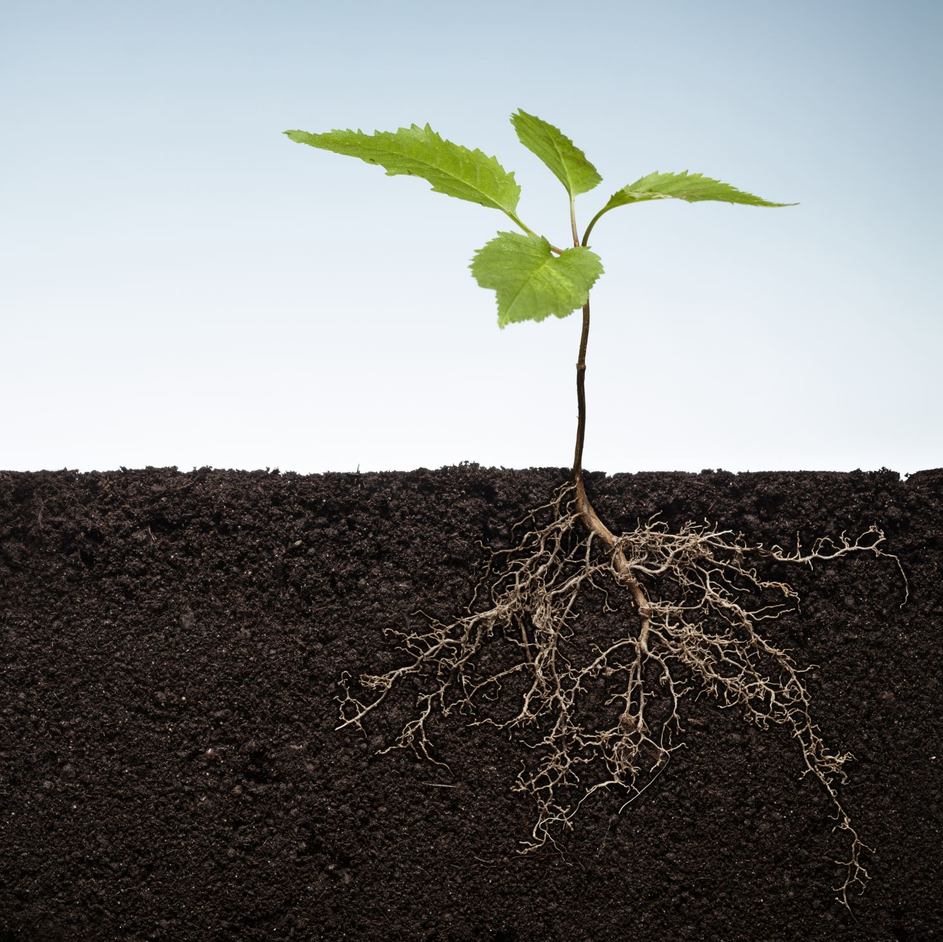
PROPOSED SOLUTION
The proposed solution is a simple agricultural information website with IoT smart farming features.
The system provides crop information, planting and harvesting guides, location-based weather data, best farming practices, and a live sensor dashboard.

Slide 6
BENEFITS
Supports better crop planning and decision-making
Helps new farmers learn modern farming methods
Helps farmers respond quickly to weather changes

Slide 7
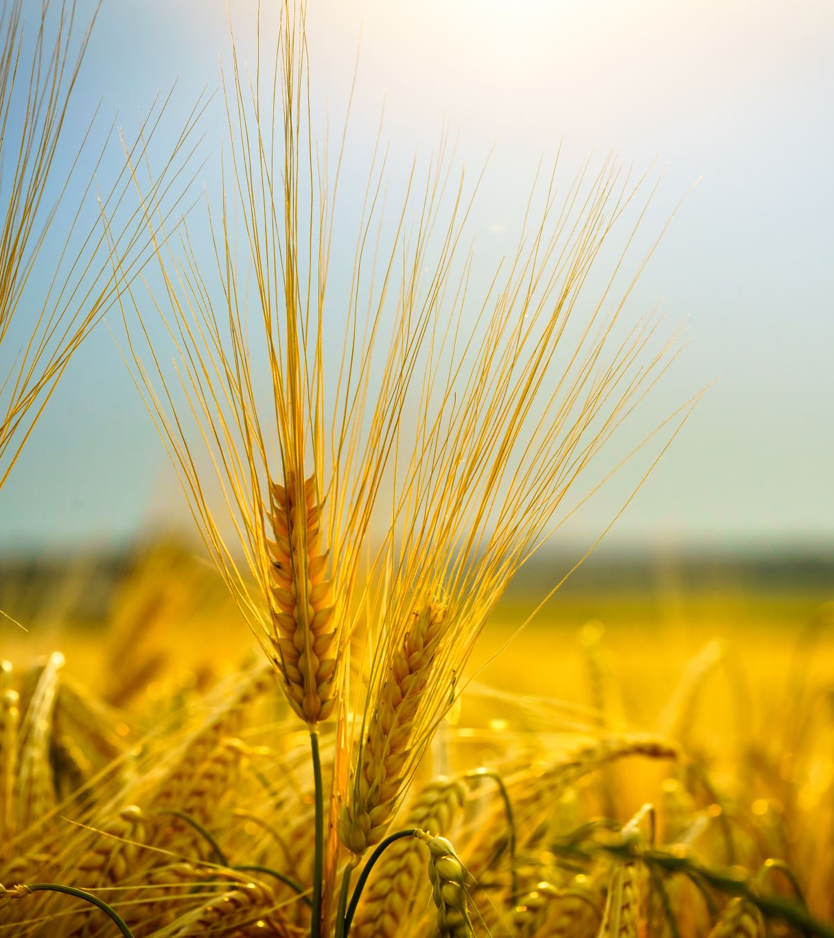
CONCLUSION
The AgriInfo Web project successfully demonstrates how digital and IoT technologies can support agriculture.
By combining agricultural information with real-time sensor monitoring, the system helps farmers improve planning, productivity, and sustainable farming practices.

Slide 8

THANK YOU

